Slide 1

Consulting services database
Team: - Nishith Burman
- Gaurav handa
Date: December 09th, 2019

Slide 2

PROBLEM
Difficulty in managing and storing the data in a systematic manner
The size of the company doubled and consequently the no. of the clients also doubled
Huge amount of data generated each day, management facing difficulty in managing it
Furthermore, analyzing and getting insights from that data became nearly impossible and time consuming

Slide 3
SOLUTION DESIGN
UNDERSTANDING THE REQUIREMENT OF BUSSINESS AND DATA
MODELING
Database should contain information about client, employees, banks, branches, partner companies etc.
ERD model should be designed to model the relationship between entities
The DDL query of the model should be used to populate the model in MYSQL

Slide 4
BUSINESS MODEL
Modeling the database in different format (e.g. ERD model, Relational model and UML model
1
2
3
ERD MODEL
UML MODEL
RELATIONAL MODEL
This modeling has basically been done to show the relationship between different entities within our database. We have used lucid chart to built.
This model is basically built in case we wanted to restrict the access of the information to the user using functions like getter and setter.
This model is one of the most comprehensive model. It not only has the relationship between different entities but also has information about the primary key and foreign relationship between entities

Slide 5

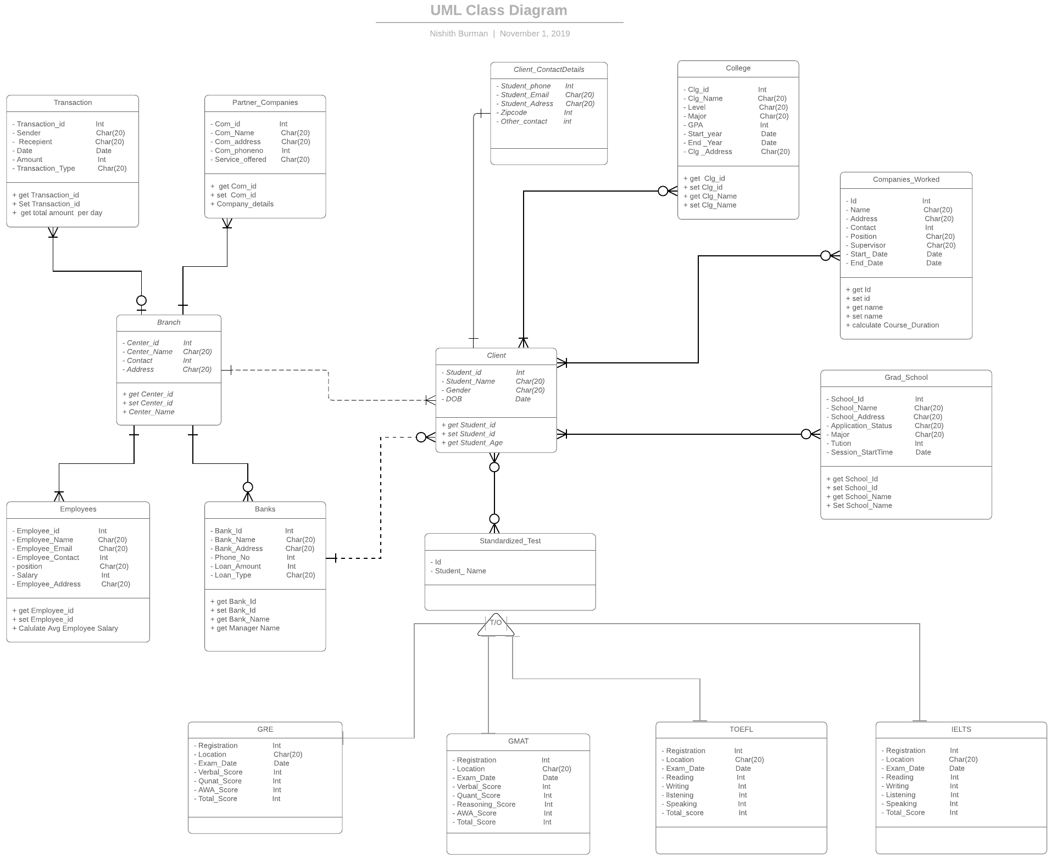
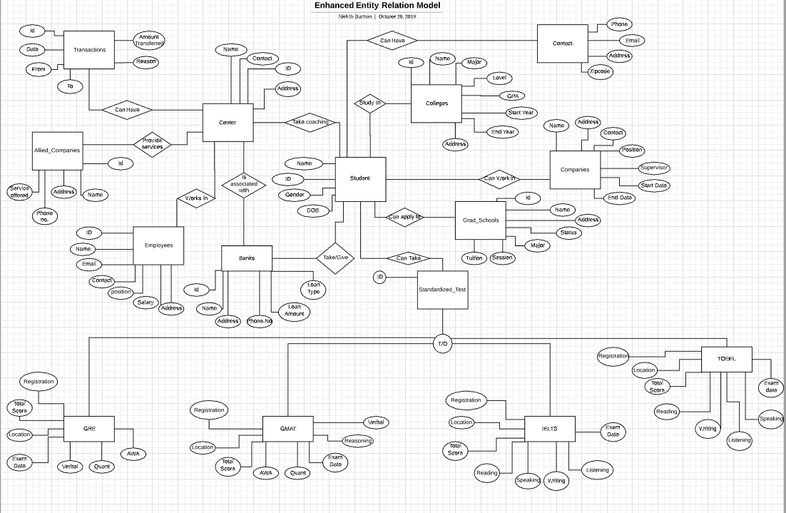
EER & UML MODEL

Slide 6

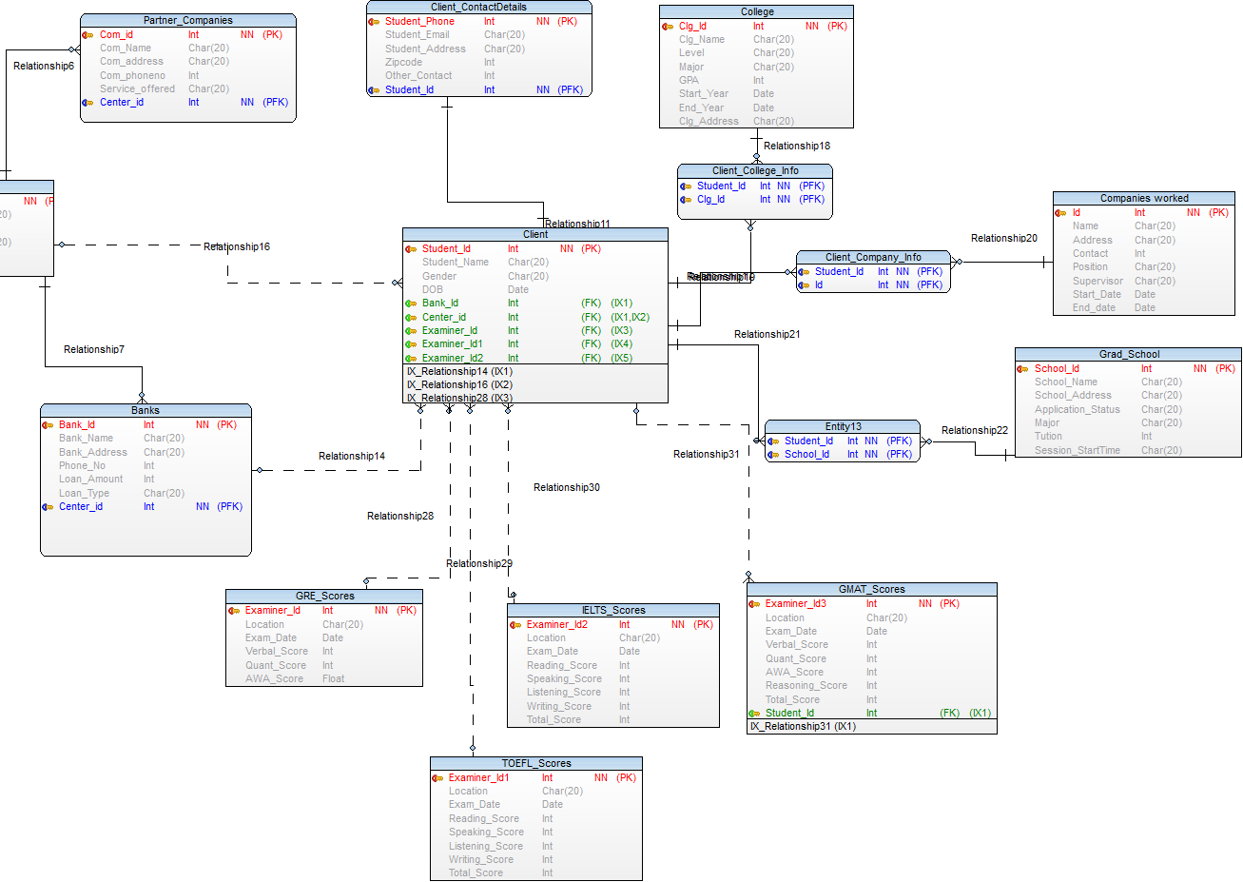
RELATIONAL MODEL
There are total of 17 different entities within that has been implemented with in the model
All the entities are related to each other with 3 different kind of relationship 1:1, 1:N, M:N
Primary key and foreign key relationship has also bee shown
The specialization aspect of data modelling cannot be shown using this format

Slide 7
Nishith Burman
Burman.ni@husky.neu.edu
Gaurav Handa
Handa.g@husky.neu.edu
THANK YOU!

